Slide 1
Laboratory work 2.2
General characteristics of Fern and Gymnosperms

Slide 2
Material:
Division Tracheophyta – vascular plants, tracheophytes
Class Polypodiopsida – leptosporangiate ferns
Order Polypodiales
Family Dryopteridaceae – wood ferns, woodferns
Genus Dryopteris – shieldfern, woodfern, wood fern, shield fern
Herbarium of Dryopteris filix mas,
Permanent cross-section preparations of Dryopteris sorus, prothallus.
Objective:
To investigate the structural features of Dryopteris filix mas
Tasks of work:
Consider and draw a general view of Dryopteris sp. with fronds, sori. Label in the picture: rhizome, adventitious roots, sori, sporangia, indusium.
Draw a structure of sori.
Note the round sori, which are exindusiate, characteristic of this family.
Draw the appearance of the prothallus, denote antheridia, archegonia, apical notch, rhizoids. Draw life cycle of Dryopteris .

Slide 3
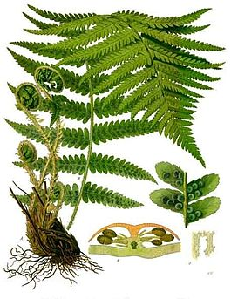
Dryopteris filix mas

Slide 4
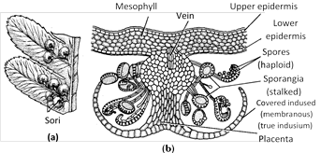
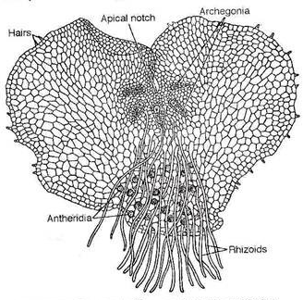
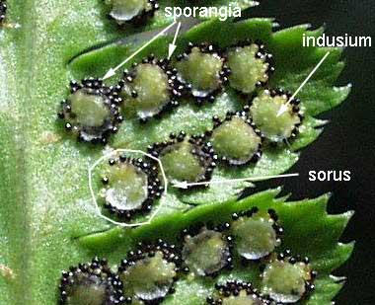
Dryopteris: (a) Part of sporophyll with sori, (b) T.S. of sorus
Dryopteris filix-mas: A mature protallus

Slide 5
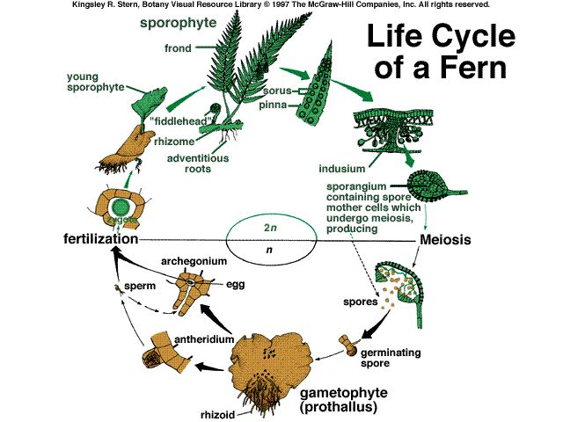

Slide 6
Material:
Division Tracheophyta – vascular plants, tracheophytes
Class Polypodiopsida – leptosporangiate ferns
Order Polypodiales
Family Polypodiaceae – common ferns, licorice ferns
Genus Polypodium – polypody
Herbarium of Polypodium sp.
Objective:
To investigate the structural features of Polypodium sp.
Tasks of work:
Consider and draw a general view of Polypodium sp. with fronds, sori. Label in the picture: rhizome, adventitious roots, fronds, sori.

Slide 7
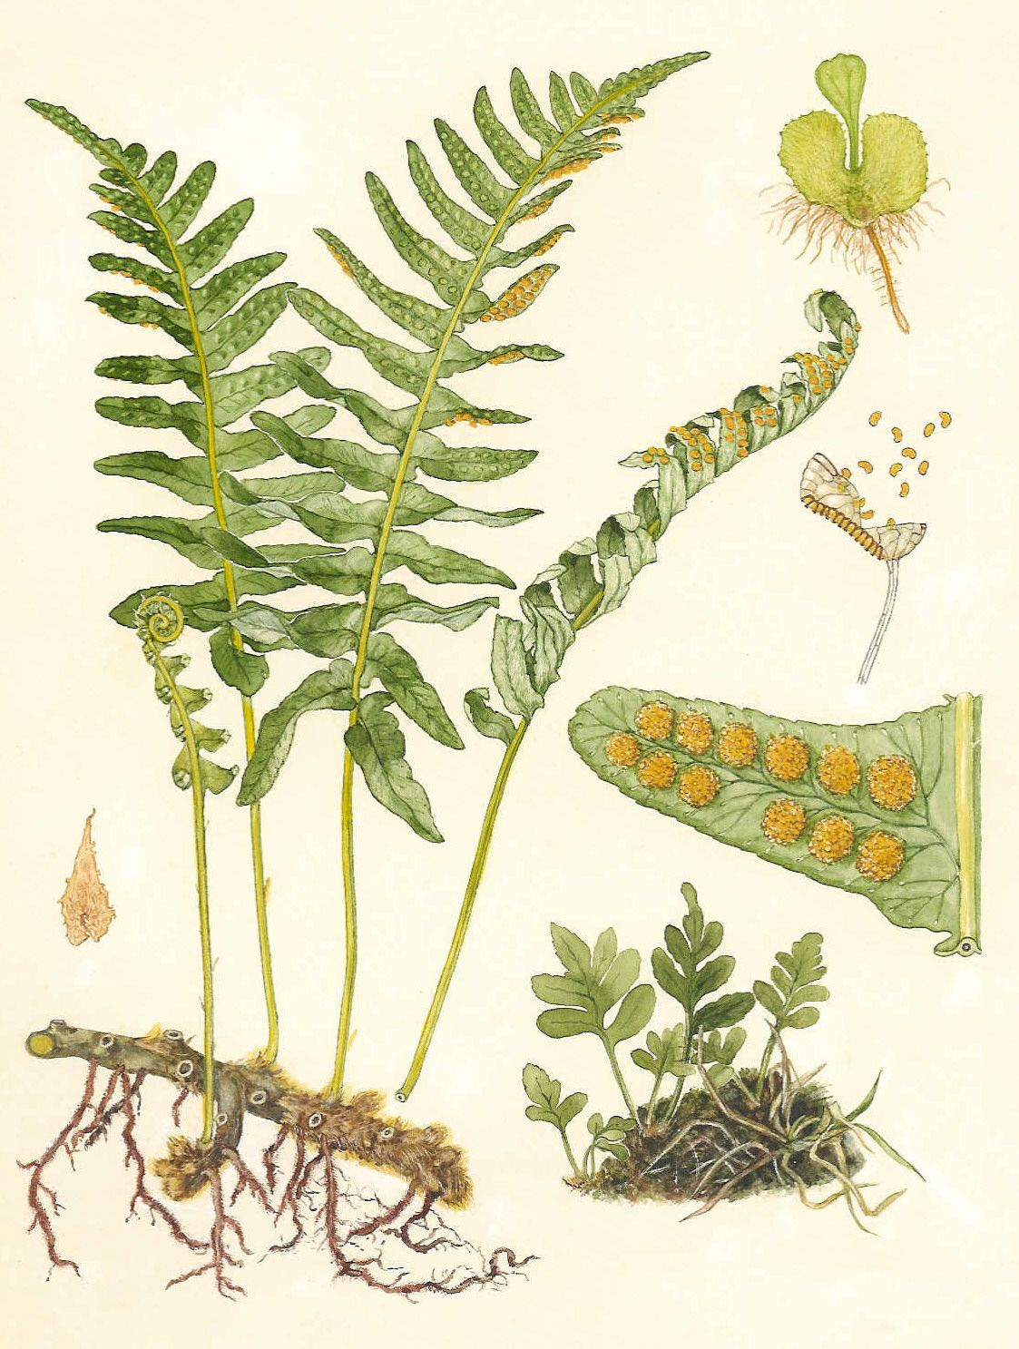
Polypodium sp.

Slide 8
Material:
Division Tracheophyta – vascular plants, tracheophytes
Class Polypodiopsida – leptosporangiate ferns
Order Salviniales
Family Salviniaceae
Genus Salvinia
Herbarium of Salvinia natans.
Objective:
To investigate the structural features of Salvinia natans
Tasks of work:
Consider and draw a general view of Salvinia natans.

Slide 9
Sporocarps
Macrosporangial sporocarp
microsporangial sporocarp
C
D
Salvinia natans
A, B – plant
C – fragment of a fruiting plant
D – macrosporangial and microsporangial sporocarp
Root-like submerged leaf
A
B

Slide 10
Material:
Division Coniferophyta - Conifers
Class Pinopsida
Order Pinales
Family Рinасеае
Genus Pinus, Genus Picea
Herbarium of Pinus sp., Picea sp.
Permanent cross-section preparation of pine tree pollen, male cones of pine, needle-like leaves.
Objective:
To investigate the structural features of pine shoot with leaves.
Tasks of work:
Examine and draw:
1. a shoot of pine, spruce (herbarium). Label an elongated shoot, shortened shoots, leaves (needles), scaly leaves, a group of microstrobil, seed cone.
2. The structure of microstrobile (slides). Consider microstrobile at a low magnification microscope, label the axis of microstrobil, individual microsporophylls, microsporangia, microspores..
3. Pollen grains (slides). Label air bags, exine, intin.
4. The appearance of female cone, of the seed. Label the seed wing.
5. Draw life cycle of pine

Slide 11
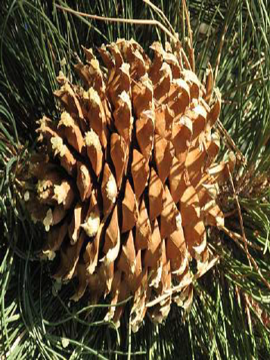
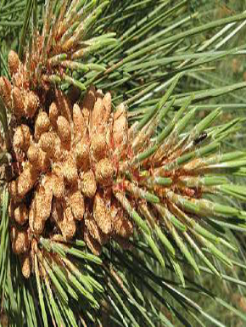
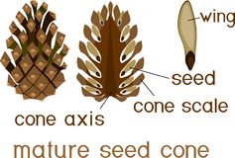
Seed cone
Group of microstrobil
Mature seed cone

Slide 12
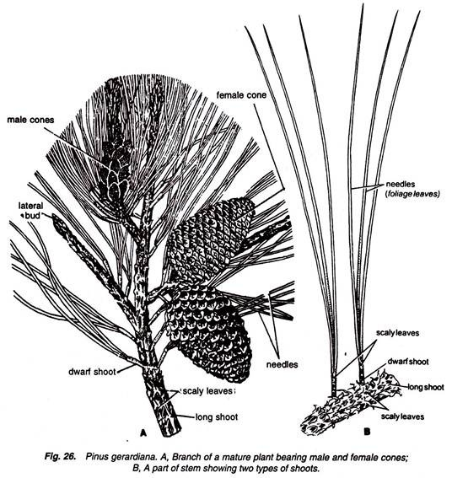

Slide 13
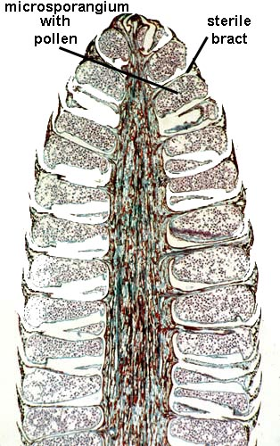
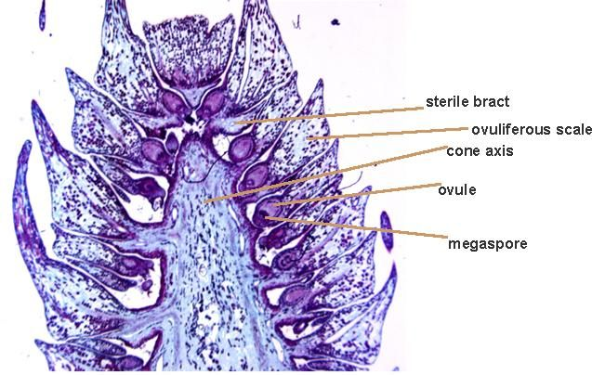
Female Pine Cone
Male Pine Cone

Slide 14
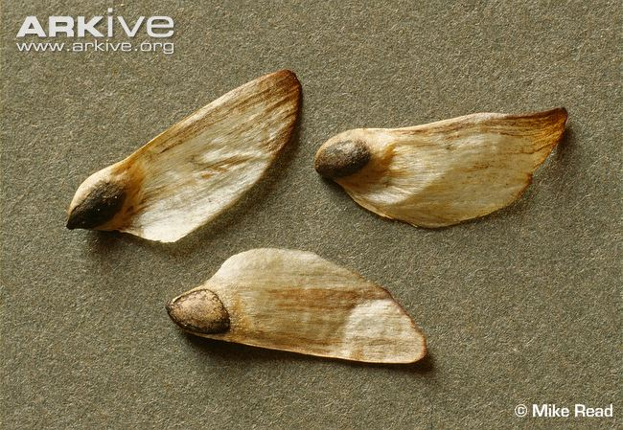
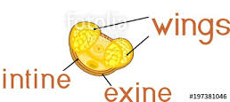
The appearance of the seed
Pollen grains

Slide 16
Material:
Division Coniferophyta - Conifers
Class Pinopsida
Order Pinales
Family Рinасеае
Pinus sibirica - Siberian pine (seeds).
Objective:
To investigate the structural features of the seed of Siberian pine.
Tasks of work:
Examine and draw:
The structure of the seed. Make a longitudinal section of the seed, draw and note: seed coat, endosperm, embryo (radicle), cotyledons.

Slide 17
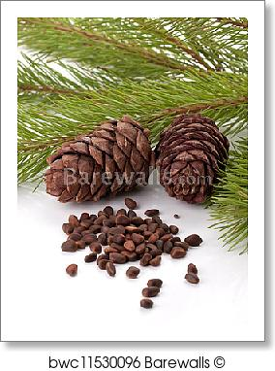
1. Seed is enveloped by a seed coat developed from the middle stony layer of the ovule.
2. Inner fleshy layer may survive in the form a thin membrane. Outer fleshy layer disappears.
3. A thin, membranous and papery structure, called perisperm, develops inner to the seed coat.
4. Well-developed endosperm is present.
5. In the centre is present the embryo consisting of a hypocotyle, radicle, plumule and 2 to 14 or more cotyledons.
Pinus single seed

Slide 18
Material:
Division Coniferophyta - Conifers
Class Pinopsida
Order Pinales
Family Рinасеае
Abies sibirica - Siberian fir
Objective:
To investigate the structural features of the shoot and leaves of Sierian Fir (herbarium).
Tasks of work:
Examine and draw:
Draw and note: elongated shoots, leaves.

Slide 19
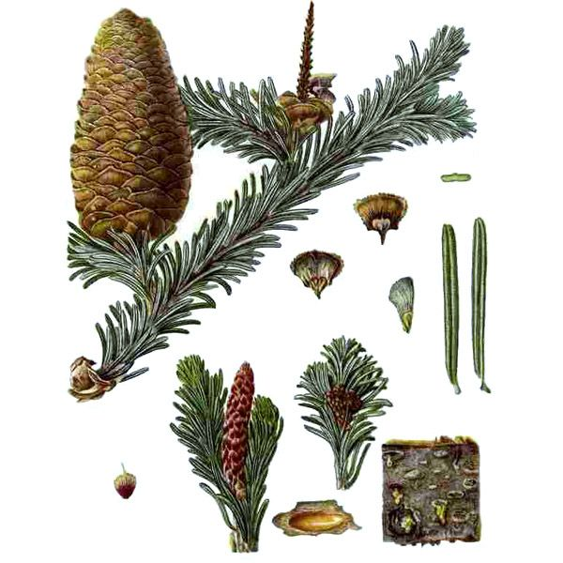
Shoot and leaves of Siberian Fir

Slide 20
Material:
Division Coniferophyta - Conifers
Class Pinopsida
Order Pinales
Family Cupressaceae – Cypress family
Juniperus sp. - Juniper
Objective:
To investigate the structural features of the shoot and leaves of Juniper (herbarium).
Tasks of work:
Examine and draw:
Juniper shoot (herbarium). Label needle-like leaves, whorled leaf arrangement, berry-like cones ("cones").
The female seed cones are very distinctive, with fleshy, fruit-like coalescing scales which fuse together to form a "berry"-like structure, 4–27 mm long, with 1–12 unwinged, hard-shelled seeds.

Slide 21
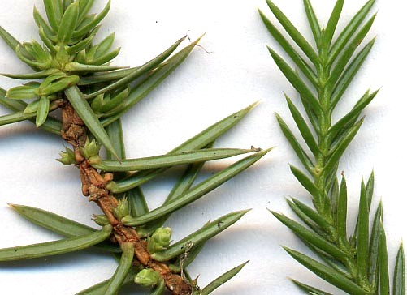
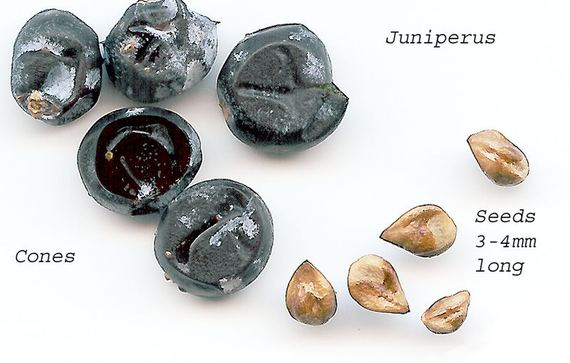
Needle-like leaves
Berry-like cones and seeds

Slide 22
Material:
Division Gnetophyta
Class Gnetopsida
Order Ephedrales
Family Ephedraceae – Mormon-tea family
Ephedra sp. – jointfir
Objective:
To investigate the structural features of the shoot and leaves of jointfir (Ephedra).
Tasks of work:
Examine and draw:
shoot of jointfir (herbarium). Label opposite arranged scale-like leaves, compound male strobilus, separate microstrobil (bracts, stalk with 2-8 microsporangia);
appearance of female strobilus, longitudinal section of female strobilus; mature female strobilus with bright colored fleshy fruitless scales.

Slide 23
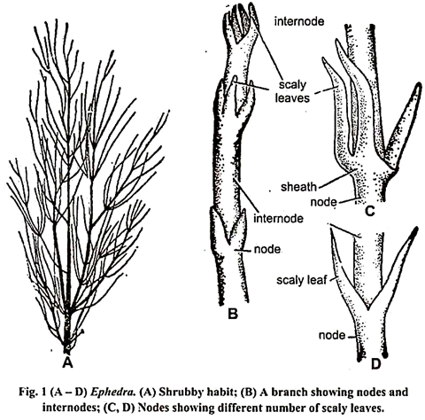
Shoot of Ephedra

Slide 24
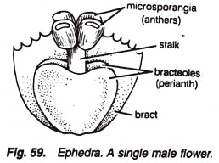
Male strobilus
A compound male strobilus
A single male flower of Ephedra

Slide 25
Female strobilus
C
A- ovulate shoots, B - female strobilus, C – L.S. of the top ovulate strobilus

